Slide 1
Volunteering in care homes
19th april 2016

Slide 2
Project overview
Purpose – evaluated the impact of volunteers on older residents’ quality of life outcomes
What we did – worked in 5 CCG areas and brokered relationships between volunteer centres and local care homes
What we achieved – positive impacts noted on residents, relatives, staff, volunteers and the care home

Slide 3
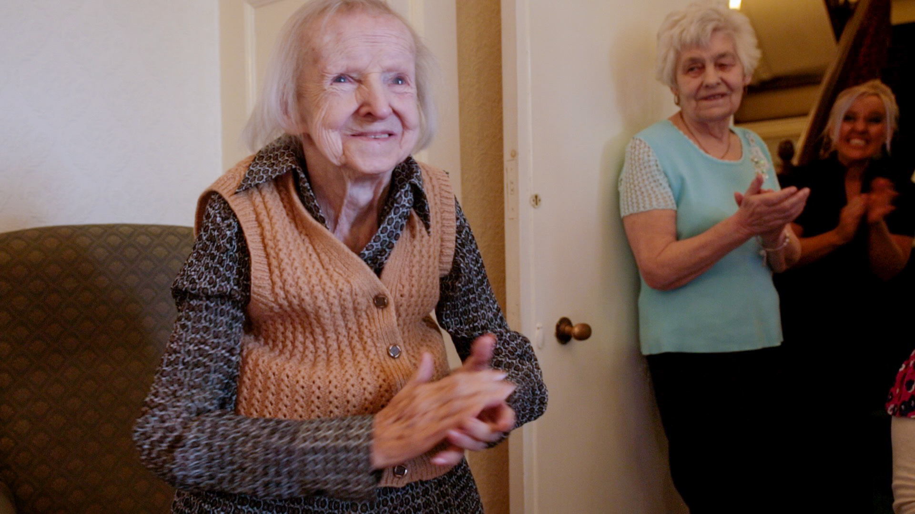
“Someone else to come in and brighten up the day of their relative” [Activities Co-ordinator]

Slide 4
“To pilot greater opportunities for young people to engage their talents and energies in volunteering relationships and activities with older residents in care homes,….. We shall disseminate the evidence of their contributions to enhancing the residents’ quality of life and celebrate these achievements”

Slide 5





Slide 6
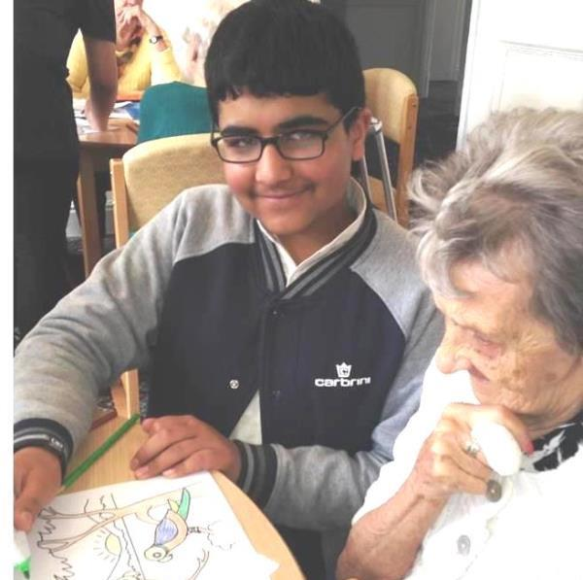
Oldham case study

Slide 7
“I was really nervous to start with and had to push myself to volunteer. I really enjoyed it…the residents liked playing games with me…I feel more confident now about leaving the house and …want to go into care work in the future”

Slide 8
Practical learning
CHALLENGES
Some younger volunteers were initially daunted by the care home environment
The care home staff did not always provide the day to day coordination or on going support of volunteers
Initially unprepared for bereavement
ACTIONS
Taster sessions
Peer support groups
Training

Slide 9
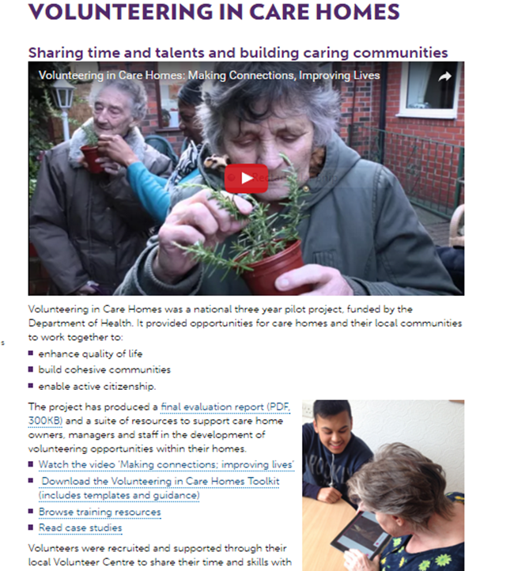
FURTHER INFOrmation
Go to https://www.ncvo.org.uk/practical-support/volunteering/volunteering-in-care-homes
evaluation report
toolkit
case studies
video
training resources

Slide 10
NCVO champions the voluntary sector and volunteer movement to create a better society.
We connect, represent and support over 11,500 voluntary sector member organisations, from the smallest community groups to the largest charities.
This helps our members and their millions of volunteers make the biggest difference to the causes they believe in.
Search for NCVO membership
Visit www.ncvo.org.uk/join
Email membership@ncvo.org.uk

